Slide 1
Secure Data Hiding in Images using Steganography
CAPSTONE PROJECT
Presented By: Piyush Pandit Bhadane
Student Name : Piyush Pandit Bhadane
College Name & Department : Sandip Institute of Technology and Research Centre (SITRC)
Information Technology

Slide 2
OUTLINE
Problem Statement
Technology used
Wow factor
End users
Result
Conclusion
Git-hub Link
Future scope

Slide 3
Problem Statement
Develop a GUI-based steganography tool using Python and OpenCV.
Allow users to embed and retrieve text messages within images securely.
Use a passcode-based encryption system to prevent unauthorized access.
Ensure efficient encoding and decoding without distorting image quality.
Provide an intuitive interface for loading images, encryption, and decryption.
Enhance secure communication by discreetly hiding data in image pixels.

Slide 4
Technology used
Libraries & Technologies Used
Python – Core programming language for implementation.
Tkinter – GUI framework for creating the user interface.
OpenCV (cv2) – Image processing for embedding and extracting text.
OS – Handling file operations like opening and saving images.
Platforms
Operating System: Windows, Linux, macOS (cross-platform support).
Python Version: 3.x (Recommended: Python 3.8 or later).
IDE/Editor: PyCharm, VS Code, or Jupyter Notebook for development.

Slide 5
Wow factors
Passcode-Based Encryption – Adds an extra security layer.
Pixel-Based Encoding – Ensures minimal visual distortion.
User-Friendly GUI – Easy encryption & decryption via Tkinter.
Multi-Channel Embedding – Hides data across BGR channels.
Cross-Platform Support – Works on Windows, Linux, and macOS.
Error Handling & Validation – Prevents unauthorized access.

Slide 6
End users
Cybersecurity Enthusiasts – For secure communication.
Forensic Experts – To hide/retrieve sensitive data.
Journalists & Activists – For covert messaging.
Students & Researchers – Studying steganography.
Developers – Exploring secure image processing.
General Users – For private message hiding.

Slide 7
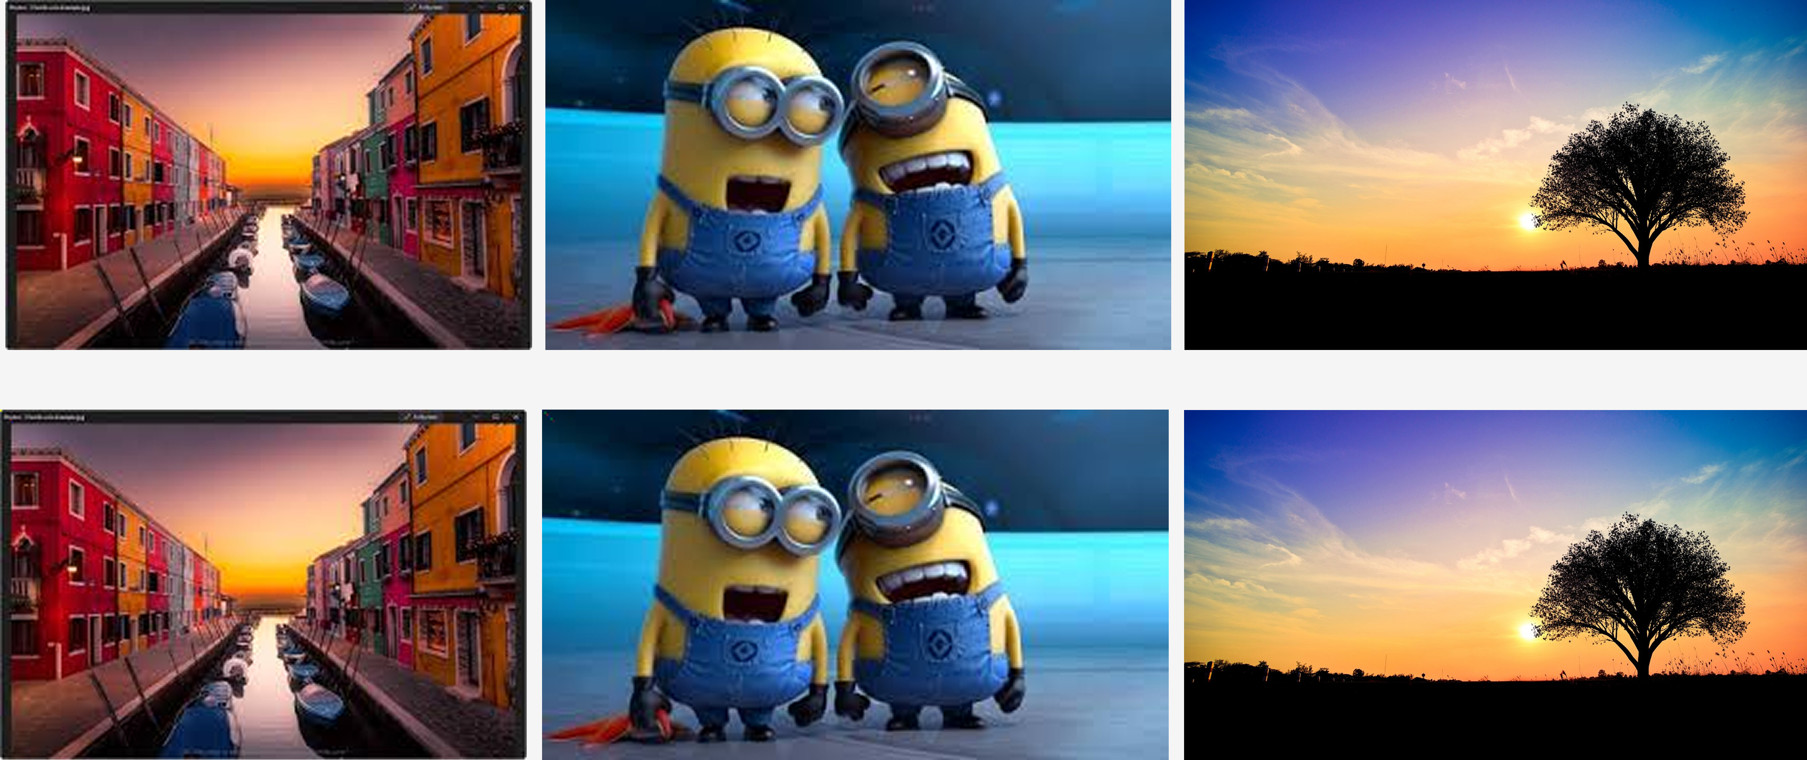
Results

Slide 8
Conclusion
This project ensures secure hidden communication using pixel-based steganography with passcode protection. Its user-friendly GUI, error handling, and cross-platform support make it accessible. Future enhancements like AI optimization and mobile integration can further improve its efficiency.

Slide 9
GitHub Link
https://github.com/PiyushBhadane55/Steganography.git

Slide 10
Future scope(optional)
Stronger Encryption – Implement AES/RSA for better security.
Multi-File Support – Extend to audio, video, and PDFs.
Stealth Mode – Enhance undetectable encoding techniques.
Cloud Integration – Secure online storage/retrieval.
AI Optimization – Reduce distortion using machine learning.
Mobile App – Develop for Android/iOS.

Slide 11
THANK YOU

